Slide 1
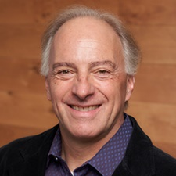
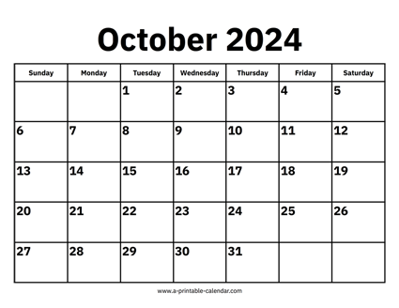

CS 310 : Scalable Software Architectures
Week 06 (Oct 28 – Nov 01)
This week in CS 310:
Focus this week:
Midterm exam, motivate lambda / serverless
Exam on Tuesday, October 29th in class
In-person, hand-written
Multiple choice, short answer, code read / write
Watch for release of Project 03

Slide 2
Topics
Cloud workloads
Execution options
Lambda expressions
Serverless computing

Slide 3
Class sessions
Tuesday:
Exam
Thursday:
Discuss exam
We’ll get back to in-class programming next week

Slide 4


Slide 5
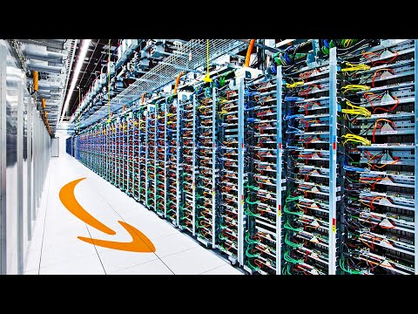
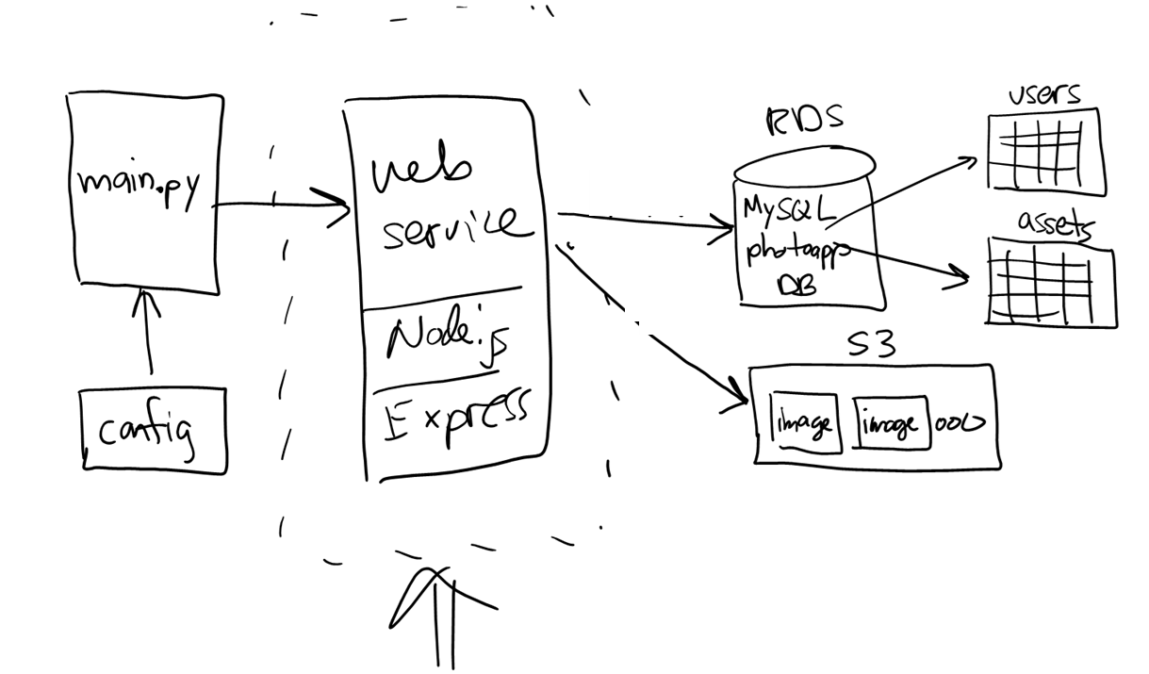
Project 02 --- complete web service in AWS
EC2
//
// PhotoApp web service
//
app.get('/stats', (req, res) => {…});
app.put('/user', (req, res) => {…});
app.get('/users', (req, res) => {…});
app.get('/assets', (req, res) => {…});
app.get('/bucket', (req, res) => {…});
app.get('/image/:assetid', (req, res) => {…});
app.post('/image/:userid', (req, res) => {…});
Notes:
EC2 = Elastic Compute

Slide 6
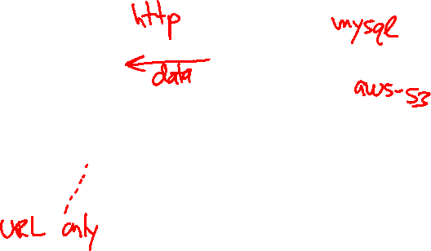
Project 02 --- complete web service in AWS
EC2
//
// PhotoApp web service
//
app.get('/stats', (req, res) => {…});
app.put('/user', (req, res) => {…});
app.get('/users', (req, res) => {…});
app.get('/assets', (req, res) => {…});
app.get('/bucket', (req, res) => {…});
app.get('/image/:assetid', (req, res) => {…});
app.post('/image/:userid', (req, res) => {…});
Notes:
EC2 = Elastic Compute

Slide 7




Project roadmap…

